Slide 2
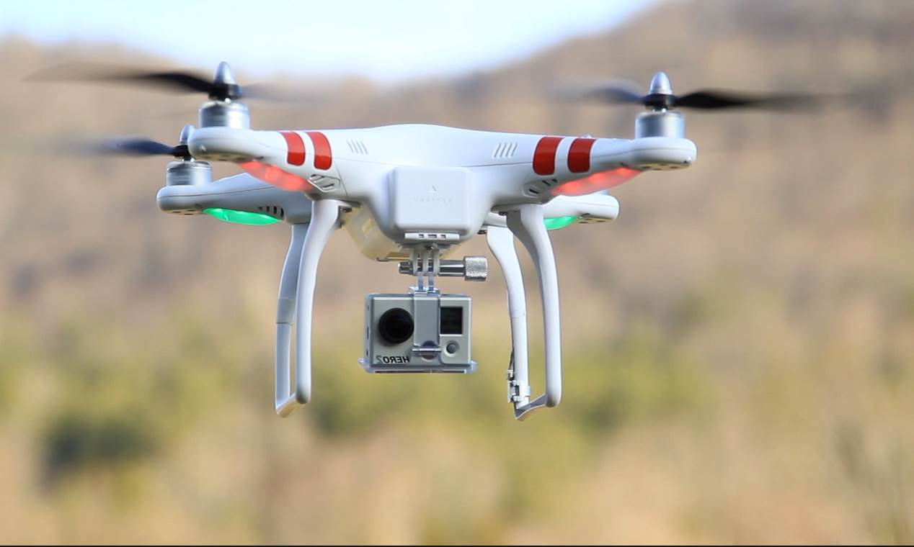
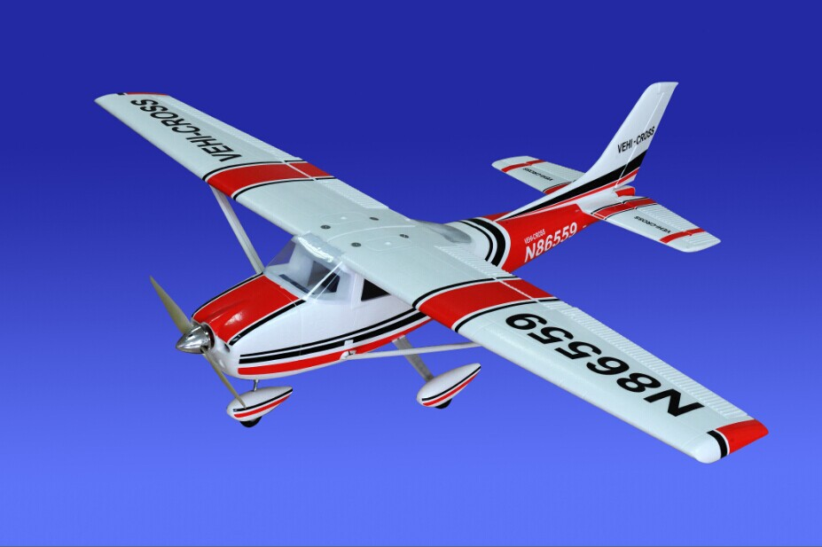
Drone
Definition: an unmanned aircraft system; remote-controlled pilot-less aircraft; flying thingy without people inside controlling it;
The FAA calls them Unmanned Aircraft Systems (UAS), but no one will argue if you call them a drone

Slide 3
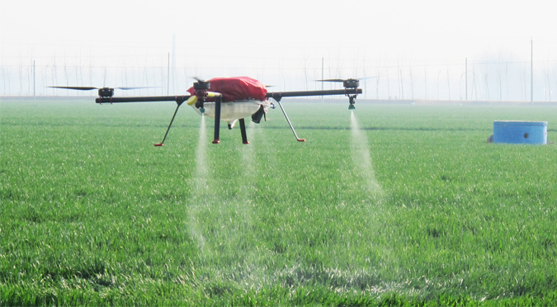
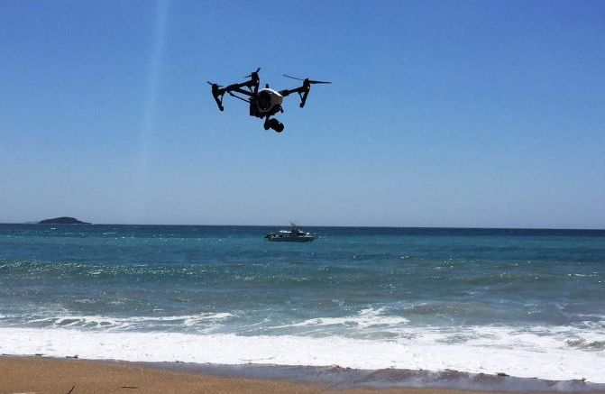
Why Fly Drones?
Aerial photography
Digital archeology
Environmental analysis
Agricultural analysis
Gas mapping
Coastal surveys
Film/media
Law enforcement
Drone racing/ first person view

Slide 4
Where Did the Term “Drone” come from?

Slide 5
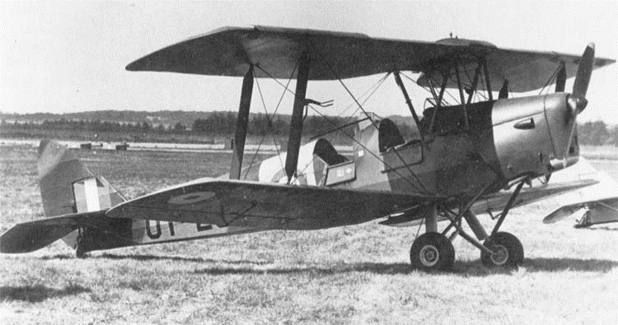
The Queen Bee (DH.82B)
Gipsy Moth, one of the most common aircrafts in UK in 1929
1935 - Put radio controls on a de Havilland Tiger Moth, a successor to the Gipsy Moth
The Queen Bee (DH.82B) was one of the first returnable and reusable UAV - used as practice targets.
Aircrafts have commonly been named after insects

Slide 6
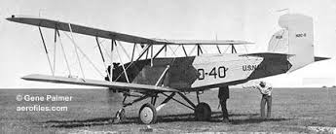
TDD-1 – Target Drone Denny 1
Reginald Denny career as actor and radio control model aircrafts
Contract signed with the Navy was for TDD-1
The first instance of “Drone” being associated with remotely piloted vehicle

Slide 7
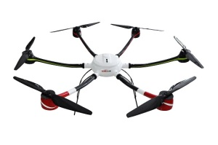
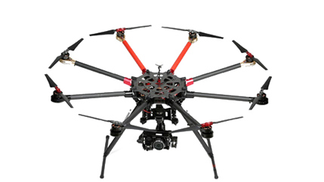
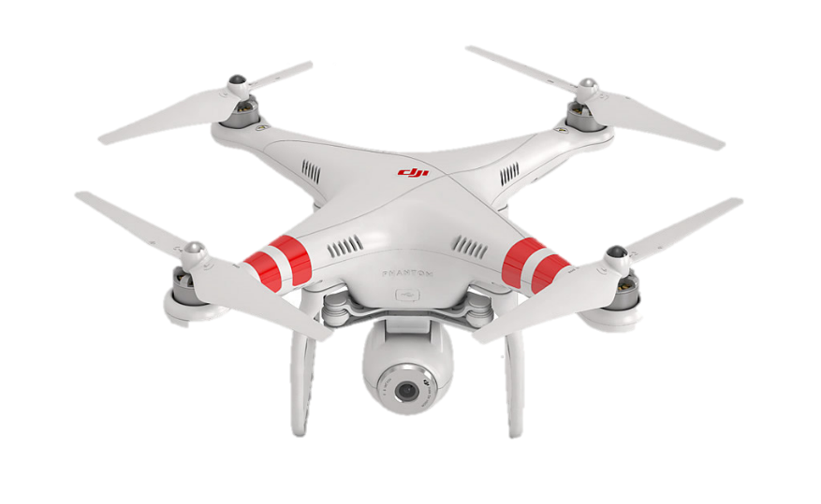
What are Some Other Names of Drones?
Quadcopter
Multicopter
Hexicopter
Octorotor
Hexarotor
Unmanned Aircraft Vehicle - UAV
Unmanned Aerial System – UAS
Internationally known as Remotely Piloted Aircraft Systems (RPAS)
UAS is the correct nomenclature for the FAA

Slide 8
Classification of Drones

Slide 9
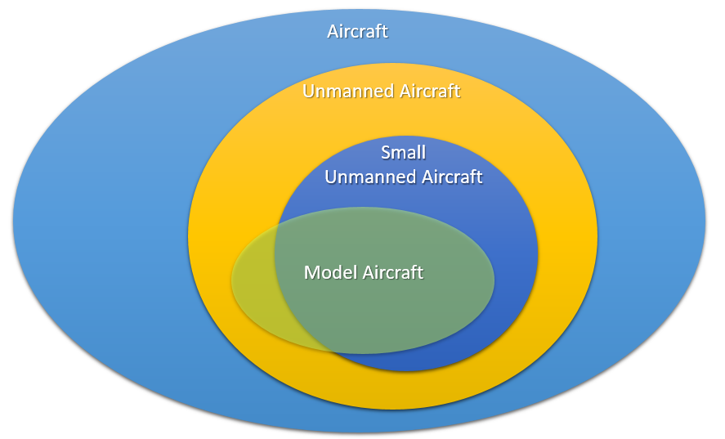
Classification Diagram
Laws that affect aircrafts affect Model Aircrafts and Unmanned Aircrafts
Laws that affect Unmanned Aircrafts also affect Model Aircrafts

Slide 10
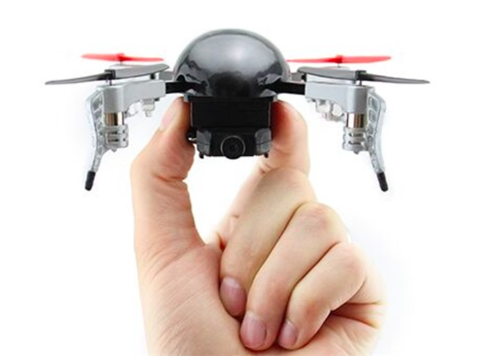
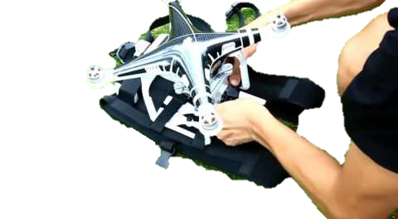
Classification of Drones
Drones classified by weight
Small Unmanned Aircraft System < 55 lbs
“micro” < 4.4 lbs
Model Aircrafts classified by the purpose of only recreational
Drone racing drones classified by size

Slide 11

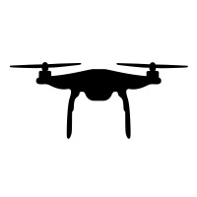
How Long do Drones Fly?
Time (Minutes)

Slide 12
Flying UAS

Slide 13
What Permissions are Needed to Legally Fly?
Federal Aviation Administration (FAA) - must register vehicle with FAA and have authorization to fly
Section 333 – any aircraft operation in national airspace requires a certificated and registered aircraft, a licensed pilot, and operational approval
Certificate of Waiver or Authorization (COA) - authorization by Air Traffic Organization for specific UA activity
Part 107 - simplifies current laws, announced JUNE 2016

Slide 14
What Items Do You Need To Legally Fly?
Recreational
License number registered with FAA displayed on aircrafts
Registration fee $5 per person
Commercial
Section 333 Exception or Aircraft Certification
Certificate of Authorization (COA)
Aircraft Registrations and Markings
Pilot Certificate
Registration $5 per aircraft
Maybe, Certificate of Authorization (COA)

Slide 15
Recreational/Class Curriculum
Recreational
Cannot receive money or compensation
Cannot be used in furtherance with a business or official duty
Must be operated within a community-based set of safety guidelines and within the programming of a nationwide community-based organization
Education
Students may build and fly a UAS as a component of a course curriculum or senior project
UAS flights by students must be in accordance with Campus oversight.
UAS flights in pursuit of research projects or university business are not considered recreational

Slide 16
UC User Flight Workflow
Where:
When:
Purpose:
Pilot:
Aircraft:
Aircraft Registered?
Flight Request
To Center
(UC form)
Flight Authorized
UC UAS Fleet Management System under development!
Licensed Pilot
File NOTAM (online system)
Clear Airspace?
Flight!
Flight Report
(UC form)
File special permission with FAA

Slide 17
Where can we fly?

Slide 18
Where is it legal to fly? Where is it safe to fly?
Legal
Class G airspace
Under 400 ft altitude
Within Line of Sight
Outside of 5 NM of an airport
Other locations will require additional FAA authorization
Safe
No flying over non-participants
Area should be secured or very likely to have no incursions
Spectators should be
65 ft away for planes
25 ft away for multirotors (quadrotors)

Slide 19
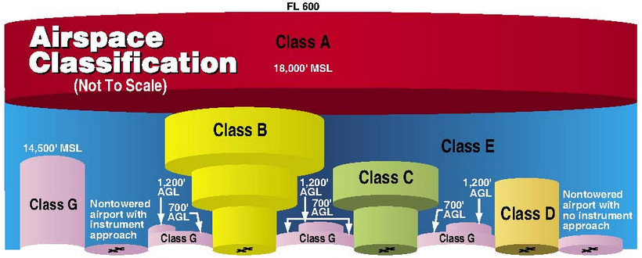
Airspace Classifications

Slide 20
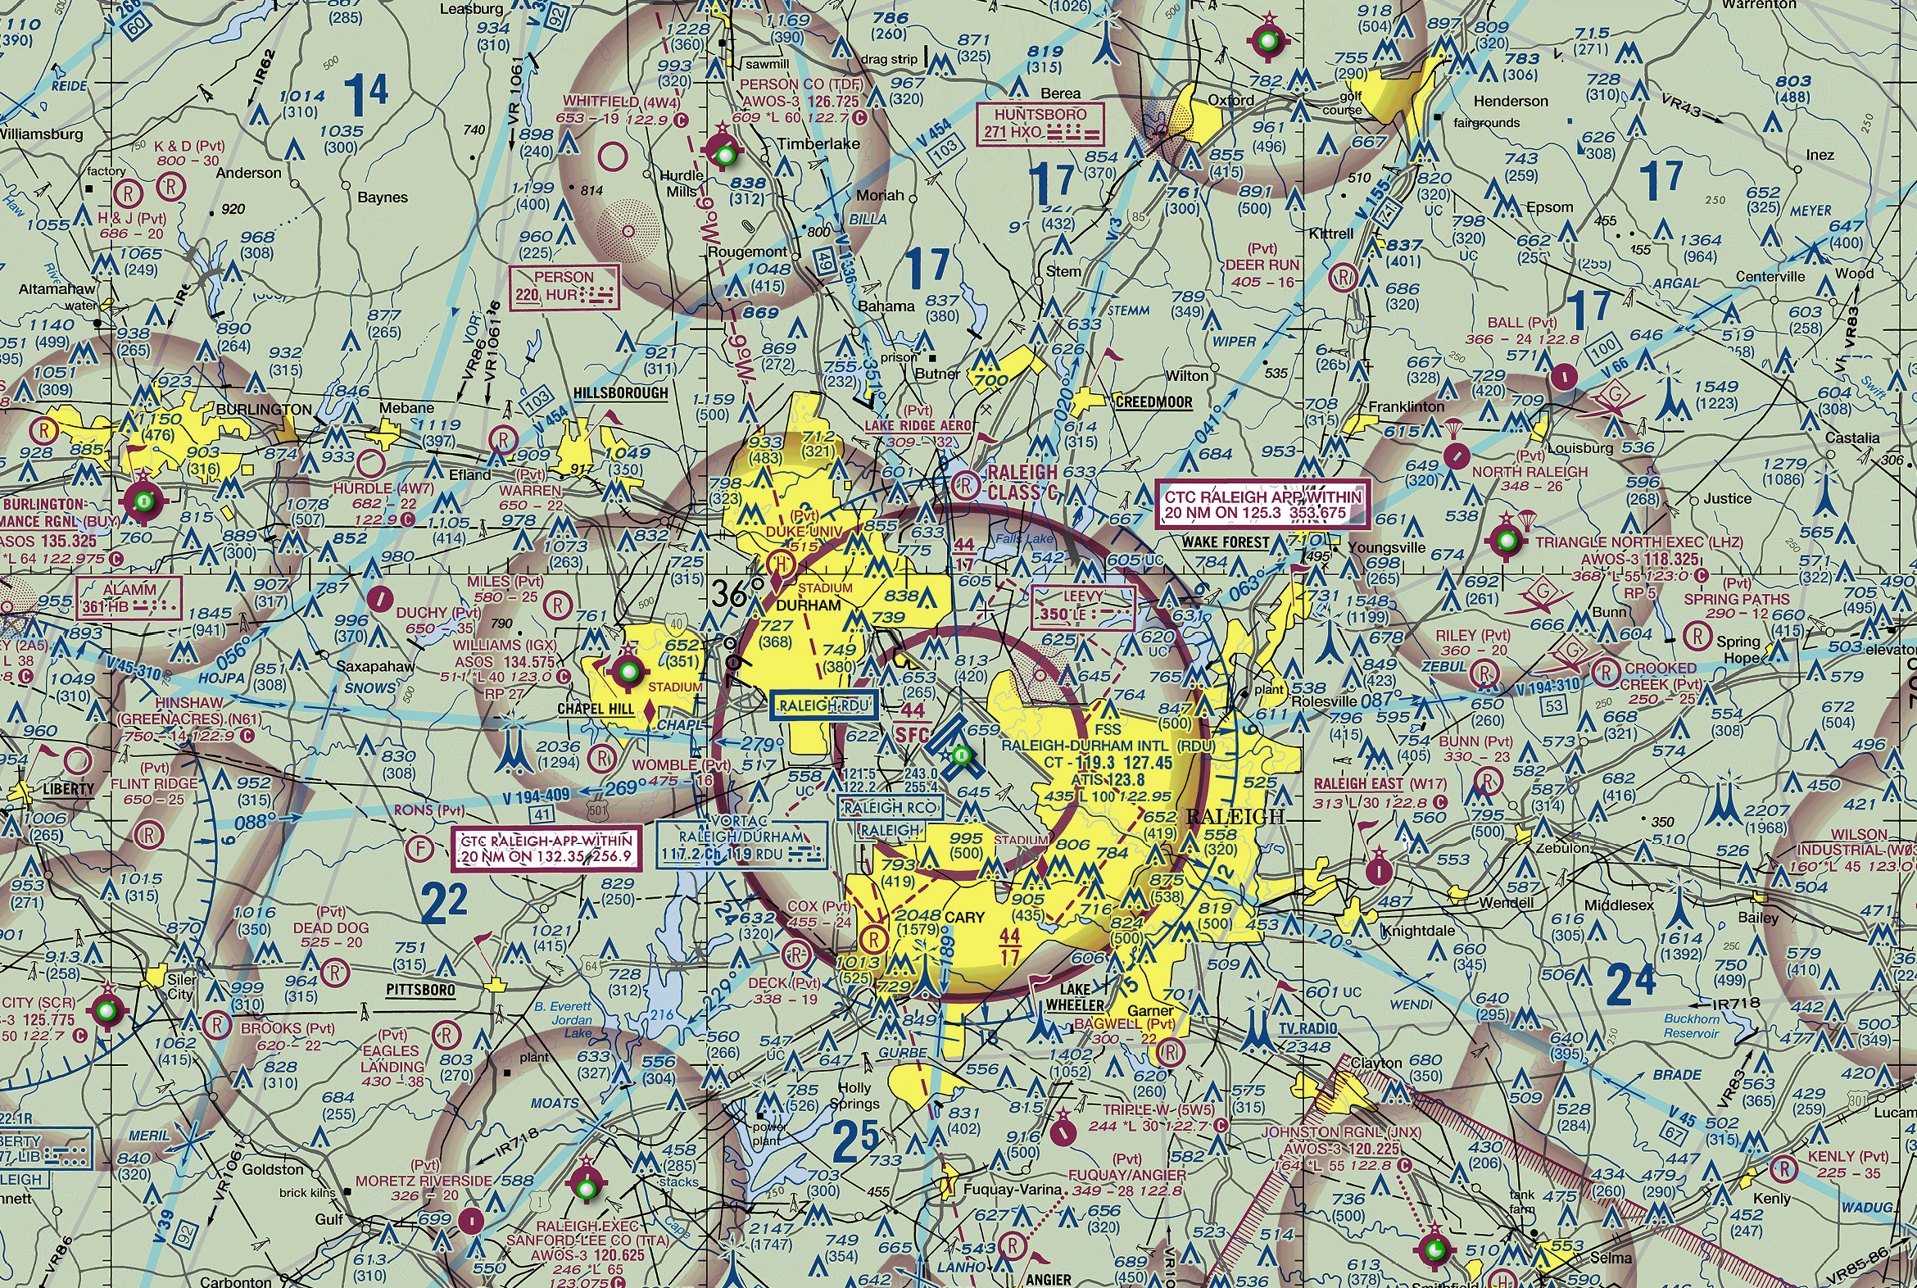
RDU Airspace
RDU is Class C
Duke and UNC have helipads
Stadiums
UNC Special Case

Slide 22
Mapping Solutions
Skyvector.com
App.airmap.io

Slide 23
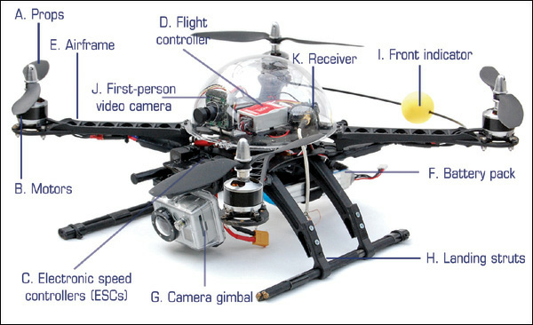
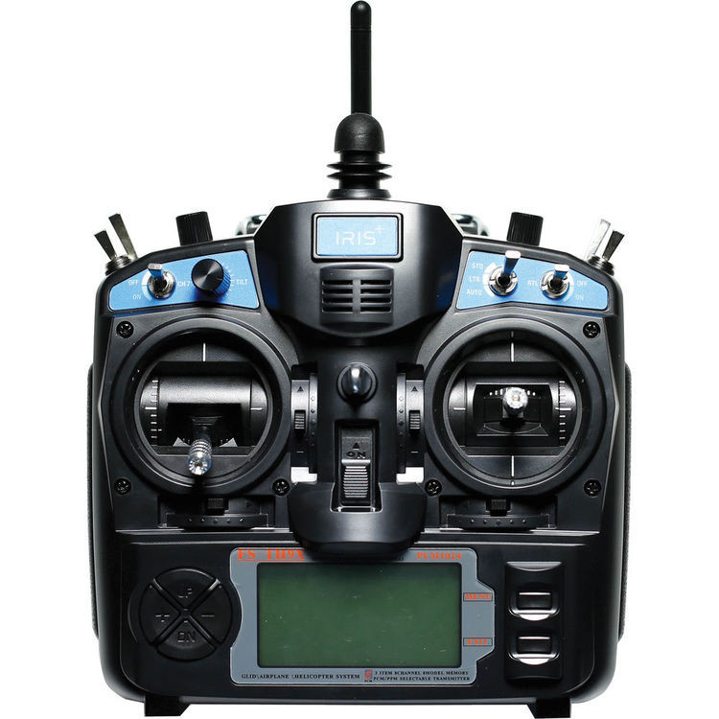
Quadcopter Anatomy
Physical
Rotors
Motors
Props
Frame
Landing Struts
Electronic
GPS Receiver
RF Receiver
Transmitter
Flight Controller
Optional
Gimbal
FPV Camera

Slide 24
How to Operate a Drone

Slide 25
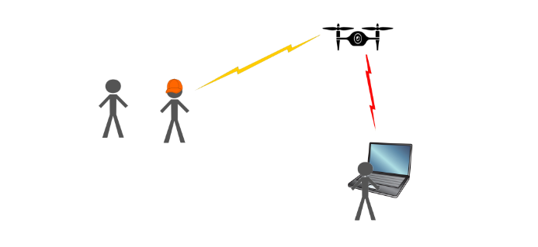
How to Operate a Drone
RC & Safety Link
PIC – Pilot in Command
Ground Control Station (GCS)
Visual Observer (VO)
Radio
Safety Link / RC Communication
Control & Communication (C2)
Control & Communication Link
Visual Observer
Pilot in Command
Ground Control Station
Crew Member
Notes:
Make a visual image showing all the items

Slide 26
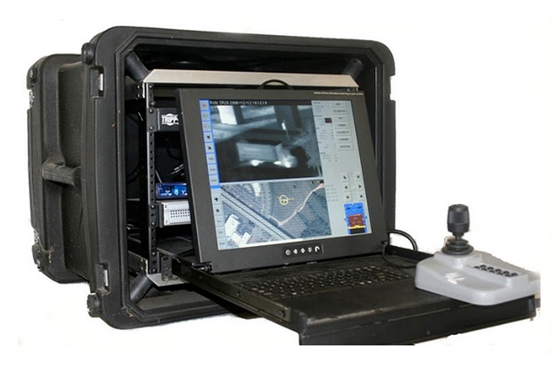
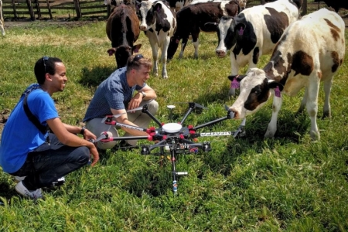
UAS Operation
A. Pilot in Command
B. Ground Control Station
The person ultimately responsible for the safety an operation of the aircraft during the flight
Abbreviated PIC
Provides the facilities and computers for human control of UAV
Abbreviated GCS

Slide 27
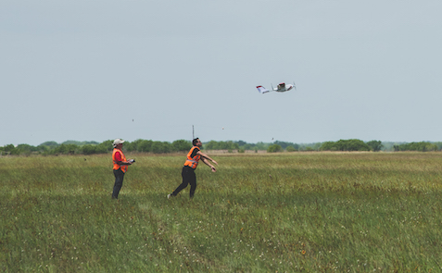
UAS Operation
C. Visual Observer
Secondary person to watch the sky for intruding aircrafts and watch the unmanned aircraft
Common practice to have a visual observer
Abbreviated VO

Slide 28
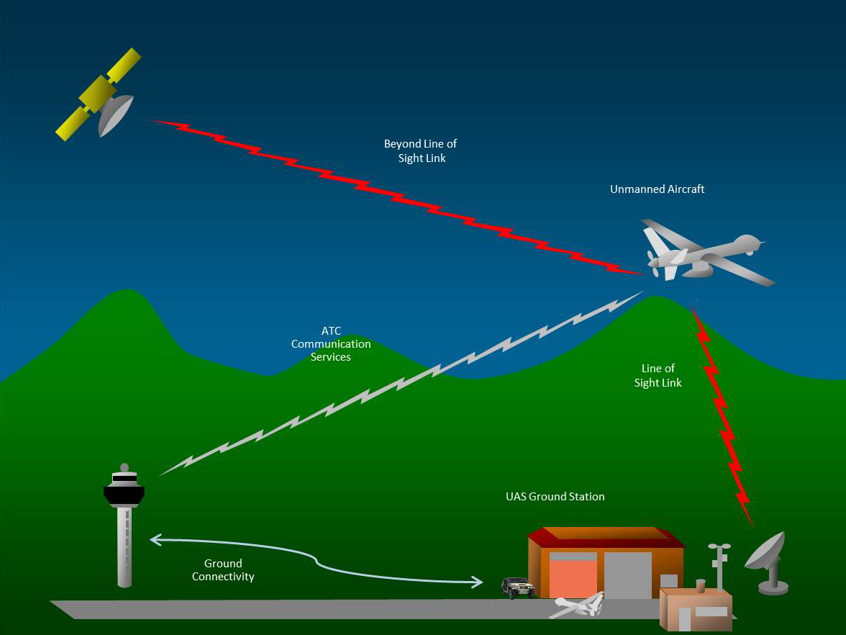
UAS Operation
Control & Communication RC Link

Slide 29
UAS Operation
F. Safety Link & RC Communication
E. Control & Communication
Flight controller used for control
Communication between flight controller and ground station typically done by radio
Abbreviated C2
Safety Link typically RC transmitter link
Could also be a different process, such as
Radio signal
Digital wifi
Linked to RC Communication

Slide 30
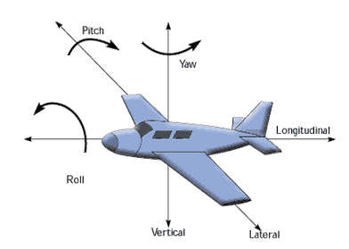
Drone Rotational Motion
Roll- rotation along the y axis
Pitch- rotation about the x axis
Yaw- rotation about the z axis

Slide 31
What Can Go Wrong?

Slide 32
Things That Go Wrong
Pilot Error!
Too windy
Loss of communication
Fly-away – Automated system error
Loss of GPS
Loss of Altitude (IMU failure)

Slide 33
Getting Trained
Register for RemotePilot101.com
Finish Sections 1 and 2 by next week.
You need to average 2.5 Sections per week to be done before Spring Break.
In-Field Drone Training
Arrive at Ranbow Soccer Field by 2:30pm
Cleland Rd, Chapel Hill, NC 27517

Slide 34
Appendix: Common UAS Key Terms (Marketing terms, special features, add-ons)

Slide 35
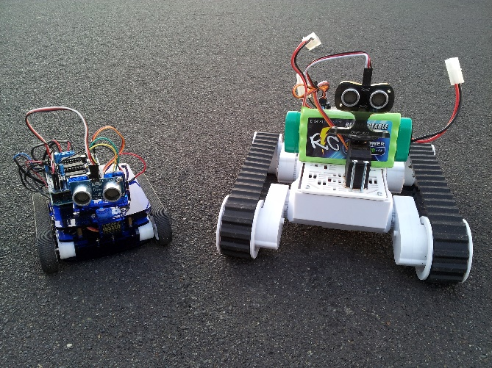
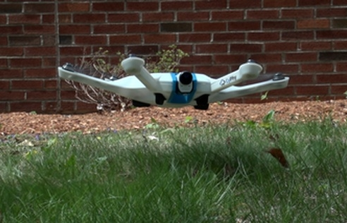
UAS Operations Key Terms
A. Autonomous
B. Altitude Hold Function
acting independently; without human control
UAV maintained at consistent altitude while roll, pitch, and yaw still changeable

Slide 36
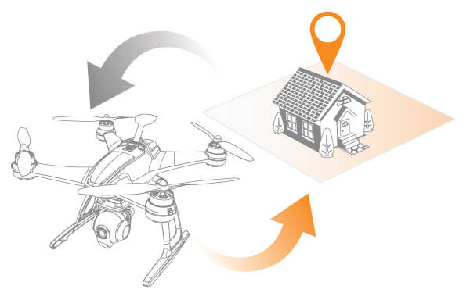
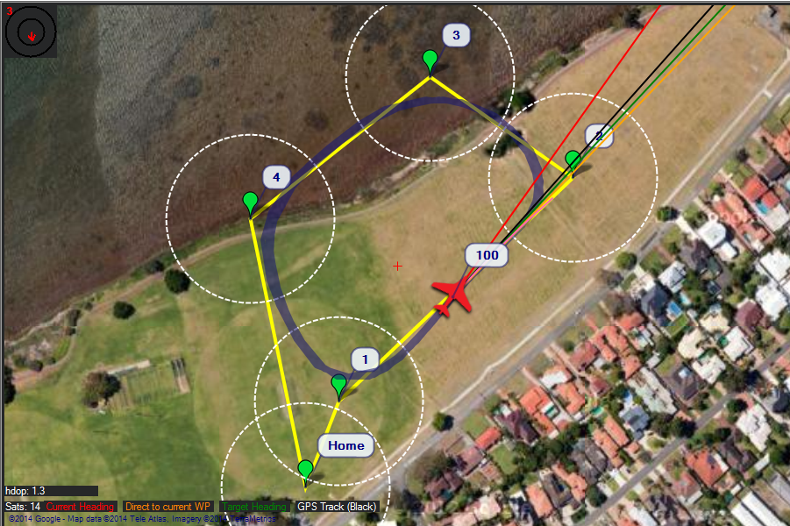
UAS Operations Key Terms
C. Return to Home
D. Waypoint Navigation
Function used to sent the UAV back to the takeoff position
UAV flies to GPS points

Slide 37
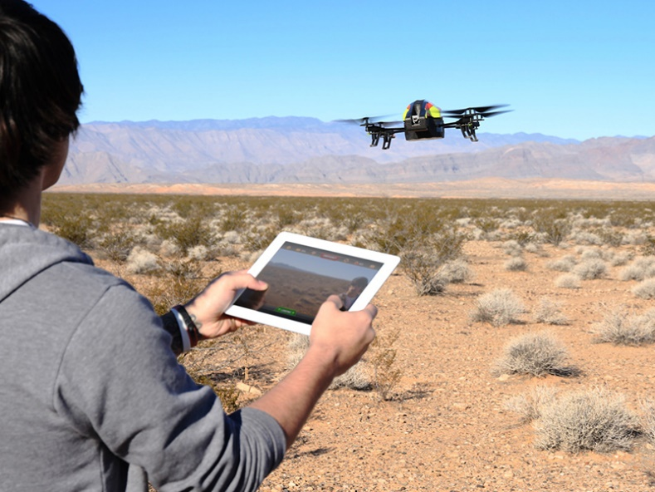
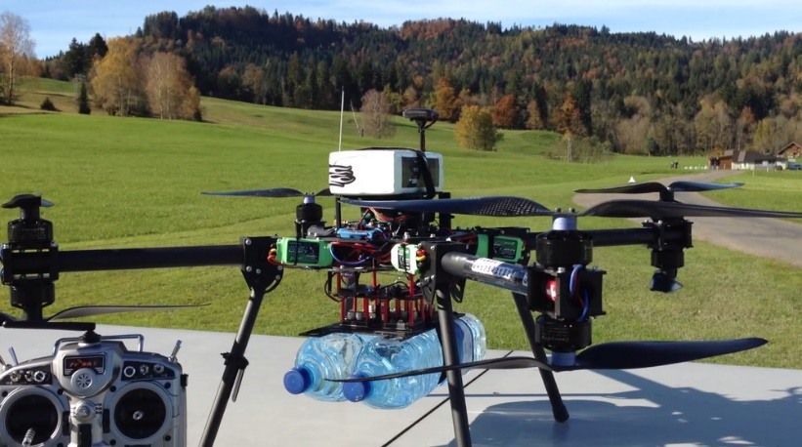
UAS Operations Key Terms
E. Manual Control
F. Payload
Flies by Not Waypoint Navigation
Someone is controlling the direct motion
Equipment being carried, such as:
Camera
Air measurements
Lasers
And so on

Slide 38
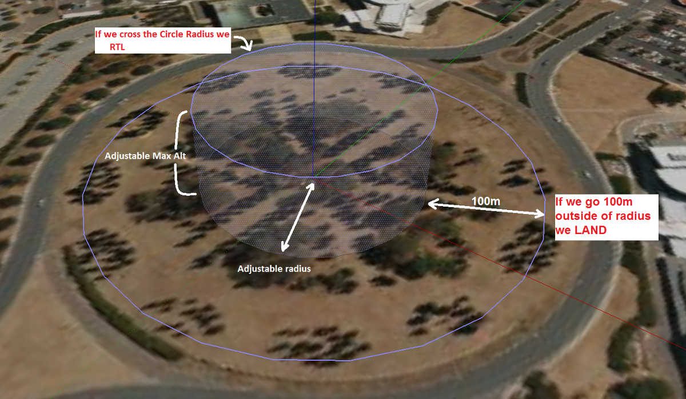
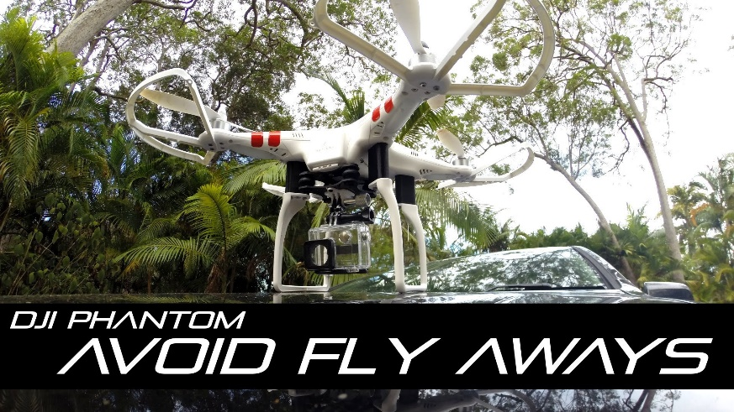
UAS Operations Key Terms
G. Geofence
H. Fly-Away Protection
GPS tells drone to never go outside the GPS range
Marketing Term used for
Geofencing
Autolanding

Slide 39
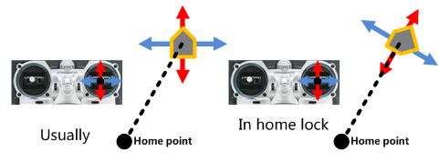
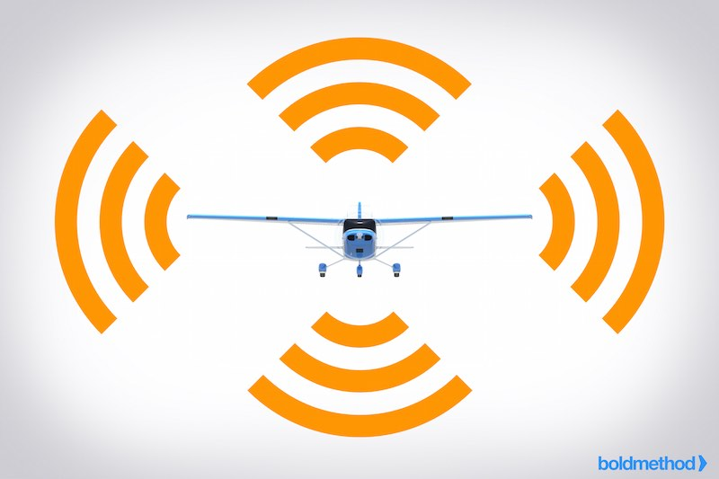
UAS Operations Key Terms
I. Intelligent Orientation Control
J. Sense and Avoid
The forward direction of the UAV is the same as the recorded nose direction, “home point”
UAV uses sensors to maneuver around obstacles and avoid collision, can use:
Cameras
Ultrasonic sensors
Lasers

Slide 40
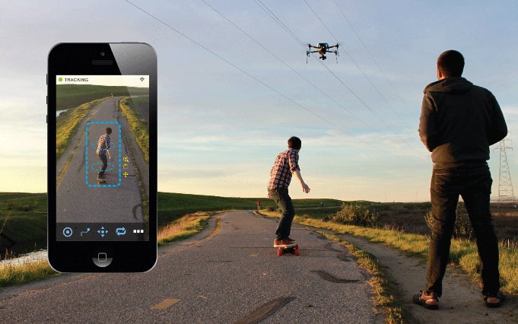
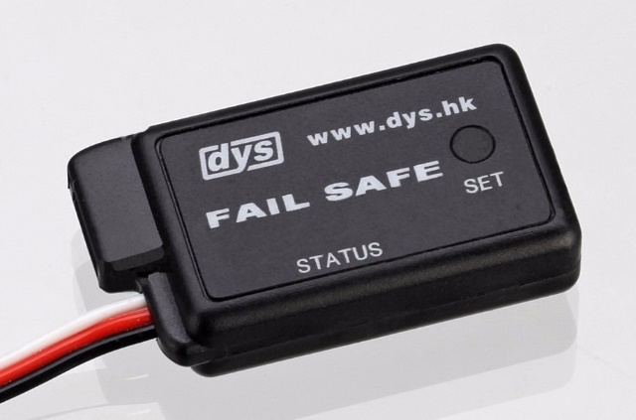
UAS Operations Key Terms
K. Visual Tracking
L. Fail-Safe
Using cameras to control the roll, pitch, and yaw to track a moving object
Prevents crash in the event of unsafe situation, such as:
Loss of GPS signal
Loss of Radio Control Signal
Low Battery

Slide 41

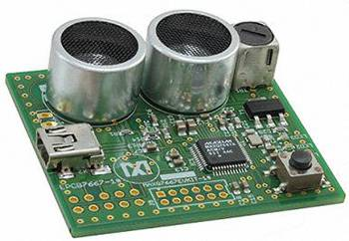
UAS Operations Key Terms
M. Arming
N. Ultrasonic Sensors
Armed aircraft is ready to fly and motors will spin when throttle is applied
Used as a safety mechanism
Equipment used for range measurements by sending and receiving a signal
Example:
Bats
Drone collision avoidance

Slide 42
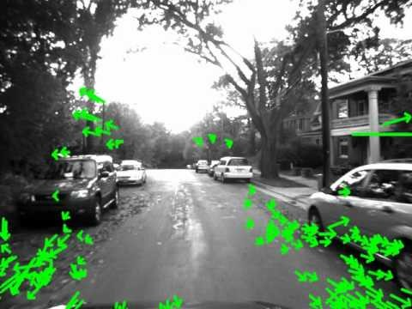
UAS Operations Key Terms
O. Optical Flow
P. Above Ground Level
Used to improve stability using a camera to detect the direction of motion
Indicates where the zero level or reference altitude is located
Abbreviated AGL

Slide 43
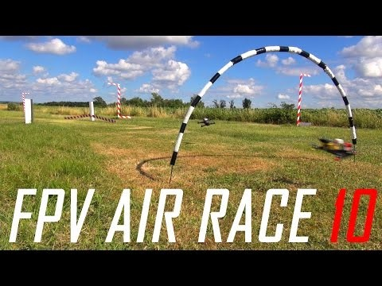
UAS Operations Key Terms
Q. First Person View
Drone racing
Watch video it’s fun

Slide 44
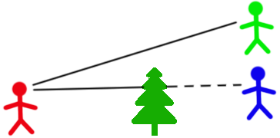
UAS Operations Key Terms
R. Line of Sight
S. Beyond Line of Sight
Straight line along which the observer has unobstructed view
Abbreviated LOS
Operator and UAV too distant or obstructed
Abbreviated BLOS

Slide 45
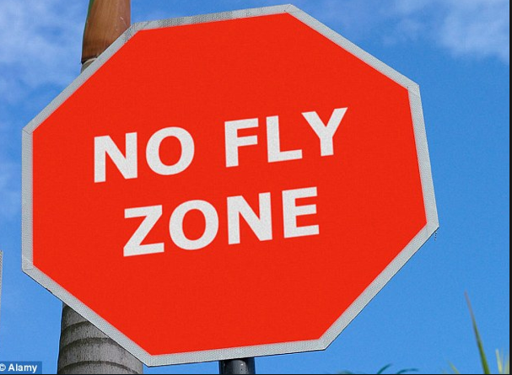

UAS Operations Key Terms
T. No Fly Zone
U. Notice to Airman
Designated area where aircrafts may not fly
Abbreviated NFZ
Notice filed to aviation authority to notify aircraft pilots of:
potential hazards along flight route
locations associated with the flight
Abbreviated NOTAM

Slide 46
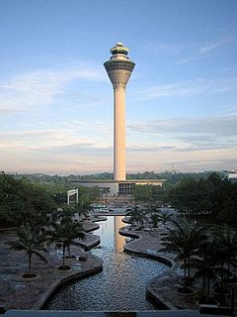
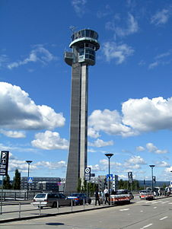
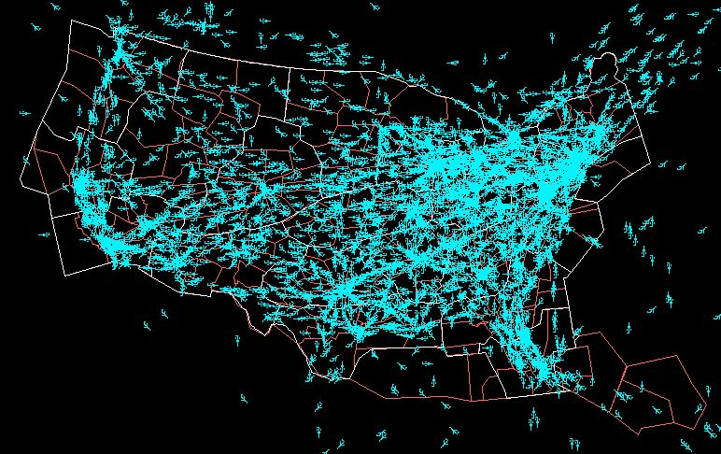
UAS Operations Key Terms
V. Air Traffic Control
W. National Airspace System
Directs aircraft traffic through controlled airspace
Abbreviated ATC
Airspace, navigation facilities and airports of the United States along with their rules and regulations
Abbreviated NAS

Slide 47
UAS Operations Key Terms
X. Total Flight Restriction
Occurs when the FAA shuts down airspace
Announced by FAA
Cannot be requested
Can occur at times of
Large stadium events
President arriving in a city
And so forth

